Slide 1
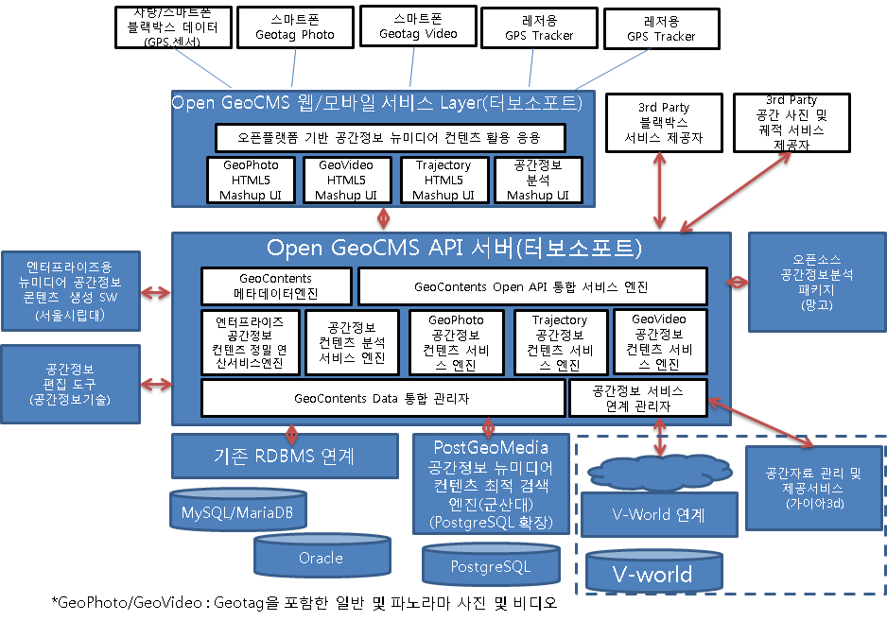
GeoCMS
Geomedia on PostgreSQL/PostGIS
GeoCMS에서의 컨텐츠 저장 분석 기술 도구

Slide 2
PostGeoMedia
GPS Trajectory
CREATE TABLE car (
id INTEGER,
number VARCHAR,
model VARCHAR,
driver VARCHAR,
traj MOVINGPOINT,
accel MOVINGFLOAT
);
CREATE INDEX trajidx ON car USING gist( traj );
SELECT id, driver, projection(traj, ‘SPATIAL’), projection(traj, ‘TEMPORAL’)
FROM car
WHERE pass( traj, box2d(10, 10, 100, 100) );
SELECT id, driver
FROM car
WHERE stayin( traj, box2d(10, 10, 100, 100), ‘over’ , ‘1 hour’ );

Slide 3
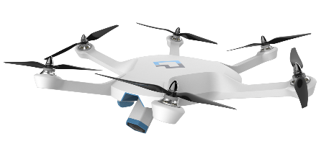
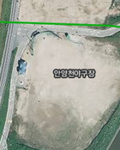
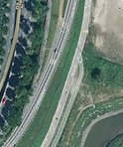
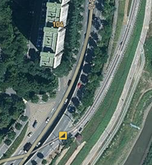
Geophoto
GeoPhoto by Drone

Slide 4
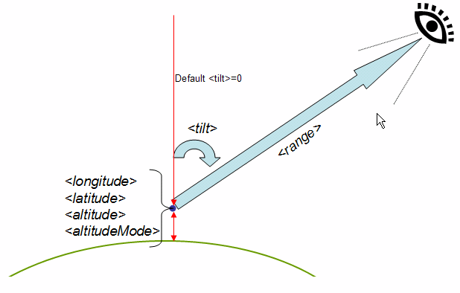

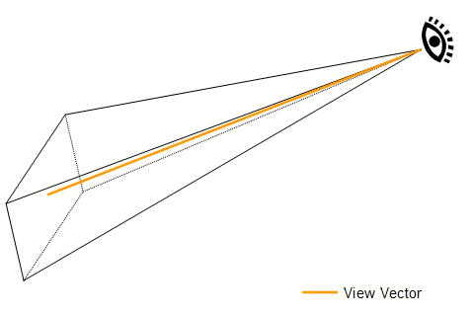
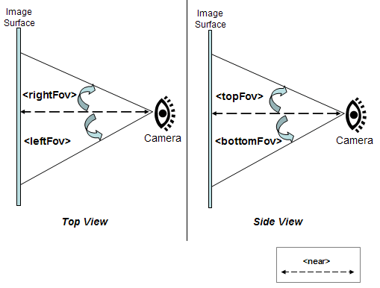
Geophoto/GPSPhoto
Geophoto ⊃ GPSPhoto
GPSPhoto
GPS Tagged Photo
Geophoto
KML Camera, Lookat + Field of View
(x, y, z)
Field of View(FoV)

Slide 5
Geophoto/GPSPhoto
Camera in KML
<Camera id="ID">
<longitude>0</longitude> <!-- kml:angle180 -->
<latitude>0</latitude> <!-- kml:angle90 -->
<altitude>0</altitude> <!-- double -->
<heading>0</heading> <!-- kml:angle360 -->
<tilt>0</tilt> <!-- kml:anglepos180 -->
<roll>0</roll> <!-- kml:angle180 -->
<altitudeMode>clampToGround</altitudeMode>
<!-- kml:altitudeModeEnum: relativeToGround, clampToGround, or absolute -->
<!-- or, gx:altitudeMode can be substituted: clampToSeaFloor, relativeToSeaFloor -->
</Camera>

Slide 6
PostGeoMedia
GeoPhoto : Drone Contents
CREATE TABLE droneFlights (
id INTEGER,
flightbegin TIMESTAMP,
flightend TIMESTAMP,
flightRegion geometry,
photoRegion geometry,
comment VARCHAR,
mphoto MOVINGPHOTO
);
CREATE TYPE movingphoto (
pid INTEGER,
traj MOVINGPOINT,
sensor MOVINGFLOAT,
gphoto GEOPHOTOS
);
SELECT id, comment, projection(mphoto.traj, ‘SPATIAL’), projection(mphoto.traj, ‘TEMPORAL’)
FROM dronefligths
WHERE pass( mphoto, box2d(10, 10, 100, 100) );
SELECT id, comment
FROM dronefligths
WHERE stayin( mphoto, box2d(10, 10, 100, 100), ‘over’ , ‘1 hour’ );

Slide 7
PostGeoMedia
PostGeoVideo
CREATE TABLE drone (
id INTEGER,
number VARCHAR,
model VARCHAR,
driver VARCHAR,
traj MOVINGPOINT,
sensor1 MOVINGFLOAT,
sensor2 MOVINGFLOAT,
gvideo GEOVIDEO
);
CREATE INDEX trajidx ON drone USING gist( traj );
CREATE INDEX gvideoidx ON drone USING gist( gvideo );

Slide 8
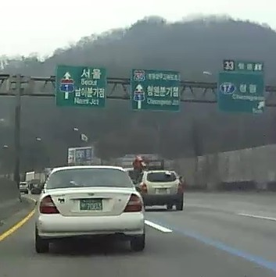
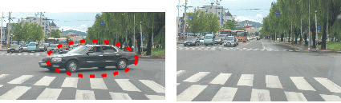
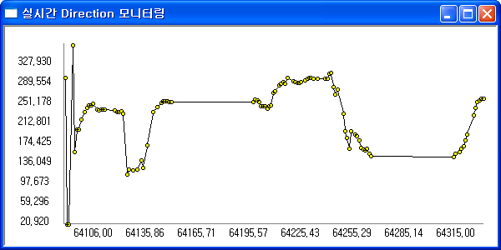
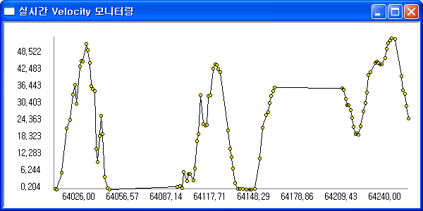
PostGeomedia
Blackbox
Drone
GPS
Sensor
Video
PostGeoMedia Integration Layer
Query UDF Extension
Moving Feature Table
Trajectory
SubTable
Sensor
SubTable
Video
SubTable
index
index
index

